Slide 1
Enterprise Risk Assessment Framework
Aligned with ISO 31000
Sachin Verma
MSc in Business Analytics

Slide 2
Objective & Scope
Overview of the purpose, organizational context, and framework alignment
Establish a structured approach to identifying, assessing, and managing enterprise risks
Assess risks across operational, financial, technology, compliance, and third party domains within the organization
Apply ISO 31000 principles to ensure consistent, transparent, and effective risk management practices

Slide 3
Risks identified across strategic, operational, financial, technology, compliance, and third-party domains
Risk Identification Summary
Risk Identification Overview
Enterprise-wide coverage including people, processes, systems, data, and external dependencies
Risks were identified through an enterprise-wide review of organizational activities, systems, and external dependencies. The identification process focused on capturing risks that could impact strategic objectives, regulatory compliance, operational resilience, and stakeholder trust.
Total of 28 key risks identified and documented within the risk register

Slide 4
Risk Assessment Methodology
Risk Assessment Approach
Five-point likelihood and impact scales applied consistently across all identified risks
Inherent risk assessed prior to controls, with residual risk evaluated after considering existing controls
Preventive and detective controls applied to reduce risk likelihood, impact, or both

Slide 5
Risk Assessment Results
Inherent Risk Heat Map
Inherent Risk Heat Map
 | Inherent Impact scale
Inherent Likelihood scale |  | 1 | 2 | 3 | 4 | 5
 | 5 | 0 | 0 | 0 | 0 | 0
 | 4 | 0 | 0 | 0 | 1 | 5
 | 3 | 0 | 0 | 3 | 16 | 3
 | 2 | 0 | 0 | 0 | 0 | 0
 | 1 | 0 | 0 | 0 | 0 | 0
The inherent risk heat map illustrates the concentration of risks before the application of controls, highlighting areas of higher exposure that require management attention and prioritisation.

Slide 6
Risk Assessment Results
Residual Risk Heat Map
Residual Risk Heat Map
 | Residual Impact Scale
Residual Likelihood Scale |  | 1 | 2 | 3 | 4 | 5
 | 5 | 0 | 0 | 0 | 0 | 0
 | 4 | 0 | 0 | 0 | 0 | 0
 | 3 | 0 | 0 | 0 | 0 | 0
 | 2 | 0 | 0 | 20 | 8 | 0
 | 1 | 0 | 0 | 0 | 0 | 0
The residual risk heat map demonstrates the reduction in overall risk exposure following the application of controls, supporting prioritisation of remaining risks that require ongoing monitoring or further management action.

Slide 7
Risk Treatment & Governance
Overview of risk response, accountability, and control effectiveness
Risk Treatment Strategy
Control Implementation
High and critical risks are treated through mitigation actions and continuous monitoring, aligned with the organization’s risk appetite.
Preventive, detective, and corrective controls are implemented to reduce inherent risk to acceptable residual levels.
Ownership & Escalation
Control Limitations
Each risk is assigned a clear risk owner, with escalation to senior management when residual risk exceeds appetite.
Controls reduce risk exposure but cannot fully eliminate risk, requiring ongoing review and reassessment.

Slide 8
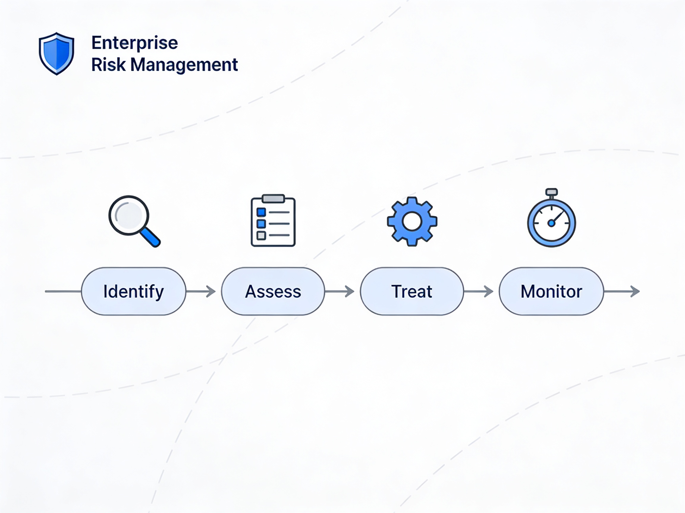
Provides a structured, ISO 31000-aligned approach to identifying, assessing, and managing enterprise risks across the organization.
Conclusion & Business Impact
Supports informed decision-making by enabling management to prioritise risks based on impact, likelihood, and residual exposure.
This enterprise risk assessment framework demonstrates a structured and practical application of ISO 31000, supporting effective risk governance and informed decision-making across the organization.
Strengthens risk maturity by embedding governance, ownership, control effectiveness, and continuous monitoring into day-to-day operations.
Establishes a scalable foundation for proactive risk management and long-term organisational resilience.

Slide 9
Thank You
Question & Discussion
Enterprise Risk Assessment Framework
Aligned with ISO 31000
Prepared by: Sachin Verma
This presentation demonstrates the practical application of enterprise risk management principles within a financial technology context.

